Slide 1
INVENTORY MANAGEMENT SYSTEM ARRAYS FOR PRODUCT CATALOG, LINKED LIST FOR SOLD ITEMS HISTORY
PRESENTED BY
24KB1A0589
24KB1A05LD
24KB1AO5NG
24KB1A05MY
24KB1A05MW

Slide 2
OBJECTIVE
The primary objective of an Inventory Management System is to efficiently track, control, and manage inventory levels, ensuring that the right products are available at the right time, while minimizing costs and maximizing profitability.

Slide 3
Data Structures Overview
Array
Structure
Simulated Linked List
Arrays are used to store products in the format Product products[MAX_PRODUCTS].
Structures are defined for both Product and Sale entities. The Product structure includes fields for id, name, quantity, and price, while the Sale.
Sales data is stored sequentially in the sales[] array. Index-based traversal simulates linked list-style behavior, allowing for efficient management of sales records.
Indexed storage
Product: id, name, quantity, price
Fixed size allocation
Sale: product_id, quantity sold, total price
Sequential storage in array
Index-based traversal

Slide 4
Why use an array for the product catalog? 1. Fixed and predictable size: The number of products is usually known to be limited (e.g., under 100), so a static array works well. 2. Fast access by index: Arrays allow O(1) time access, making it easy to search or update a product by index. 3. Simplicity: Arrays are easier to implement and debug, especially in C.

Slide 5
Why prefer a linked list for sales history? 1.Dynamic size: Sales are made continuously, so a linked list avoids the need to predefine MAX_SALES. 2.Frequent additions: Linked lists are efficient for appending new records at runtime.

Slide 6
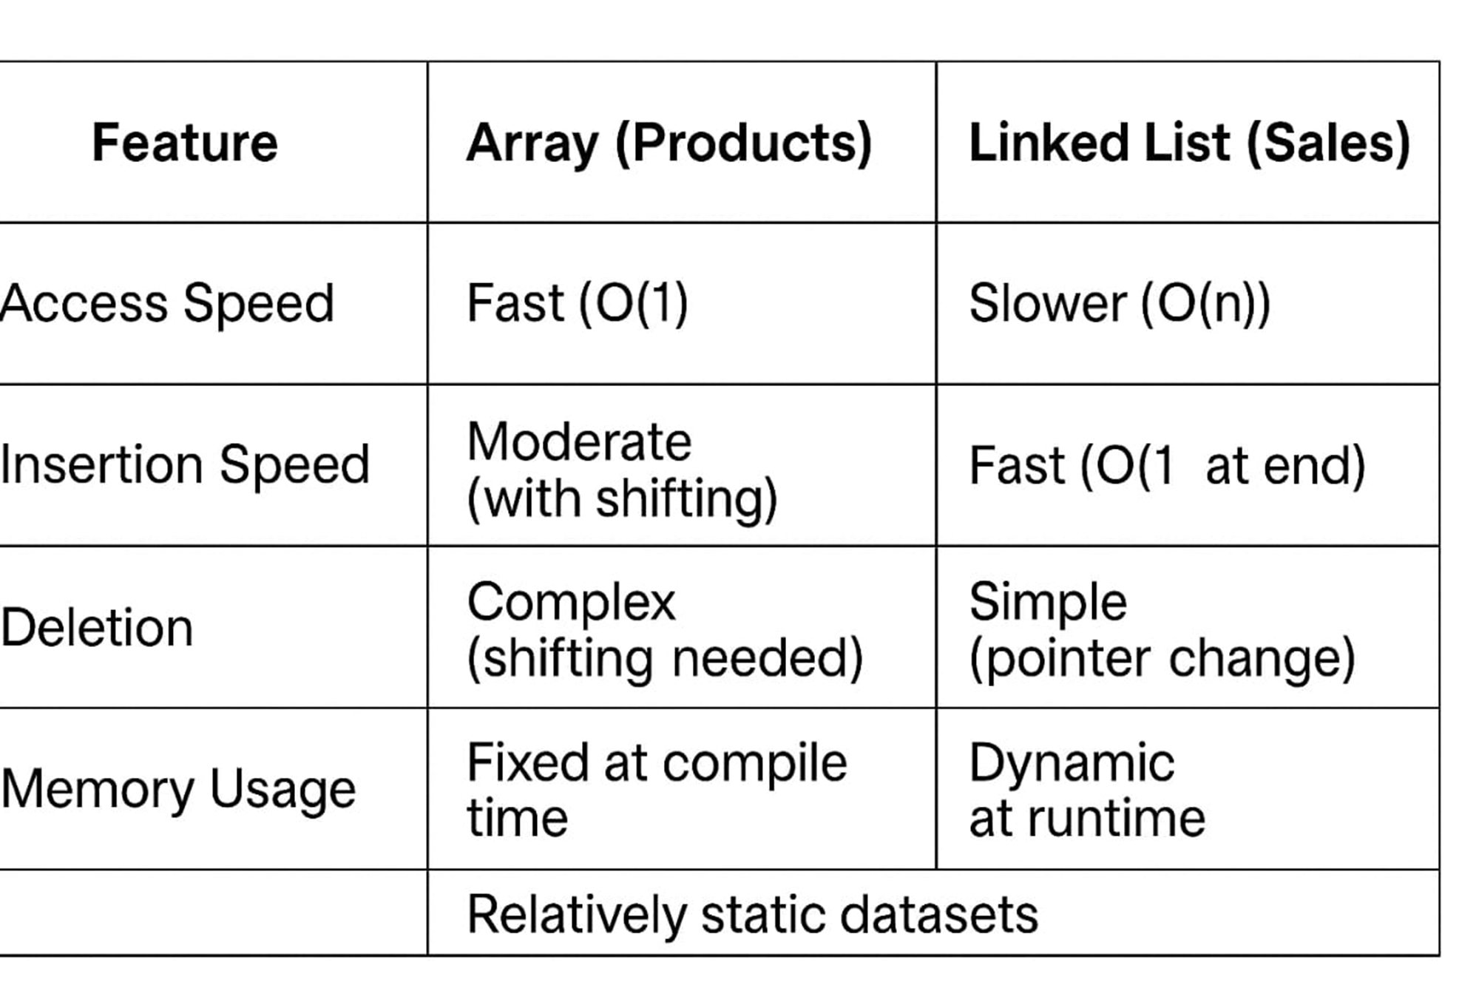

Slide 7
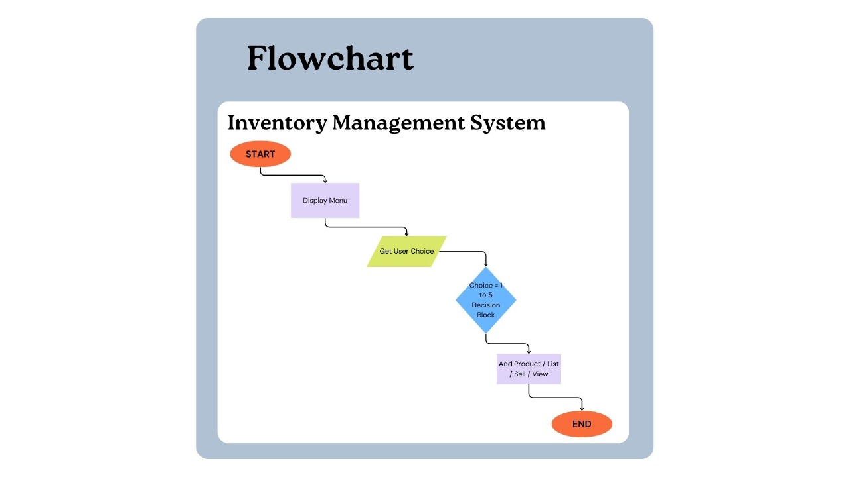
System Flowchart

Slide 8

Code Snapshot: Sales Handling
Sale Structure
sellProduct()
struct Sale {
int product_id;
int quantity_sold;
float total_price;
};
void sellProduct() {
// Code to update quantity after sale
// and record sale in sales array
}
listSales()
void listSales() {
// Code to display list of sold
// items with total price
}
The sales handling code includes the structure of the Sale and sample functions for selling products and listing sales. Key features include quantity check before sale, sale record creation, and sales listed with total value, ensuring accurate sales tracking.

Slide 9

Code Snapshot: Product Handling
Product Structure
addProduct()
struct Product {
int id;
char name[50];
int quantity;
float price;
};
void addProduct() {
// Code to collect product details
// and store in product array
}
listProducts()
void listProducts() {
// Code to display all available
// products in the system
}
The code includes the structure of the Product and sample functions for adding and listing products. The highlights include ID-based product search and input validation for product count, ensuring data integrity.

Slide 10
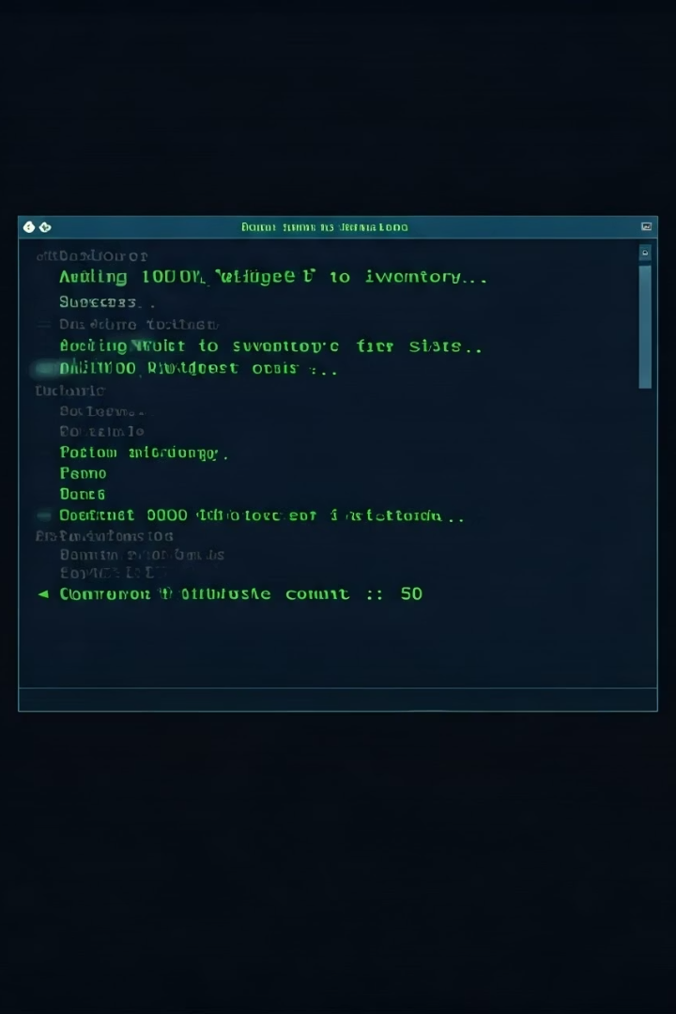
Sample Test Case & Output
Adding Products:
Apple (ID: 101, Qty: 50, Price: 2.5)
Banana (ID: 102, Qty: 100, Price: 1.0)
Selling:
Apple ×10 → ₹25.00
Output:
ID Name Qty Price
101 Apple 40 2.50
102 Banana 100 1.00
Sales: Product ID Qty Total Price
101 10 25.00
The test case demonstrates adding products such as Apple and Banana, selling a quantity of Apple, and displaying the output showing updated inventory and sales records. This showcases the system's functionality and data accuracy.

Slide 11
THANK YOU

